Slide 1
AUDIT MANAGEMENT SYSTEM
PRESENTED BY – POD 1 COHORT CODE- CDE21IJ028

Slide 2
Presented by
Shubham Swaroop Bhatnagar (2063038)
Sakshi Labhe (2063377)
Rahul Tomar (2063354)
Amit Jadhav (2063361)
Vemana Venkatesh (2063198)
Presented to
Abhijeet Mahurkar (Mentor)
Pragash Ruddar (Trainer)
R Prema (HR)

Slide 3
Problem Statement
A leading supply chain management organization is willing to automate the Audit processing in order to make the management scalable and ensure clarity and ease of tracking.
Therefore, it wants us to develop an Audit Management System.
As a full stack developer our work was to develop and deploy multiple microservices in Amazon Web Services (AWS).
The UI part was done with the help of Angular.

Slide 4
The project contains four microservices
MICROSERVICES
Audit Authorization
1
Audit Benchmark
2
Audit Checklist
3
Audit Severity
4

Slide 5
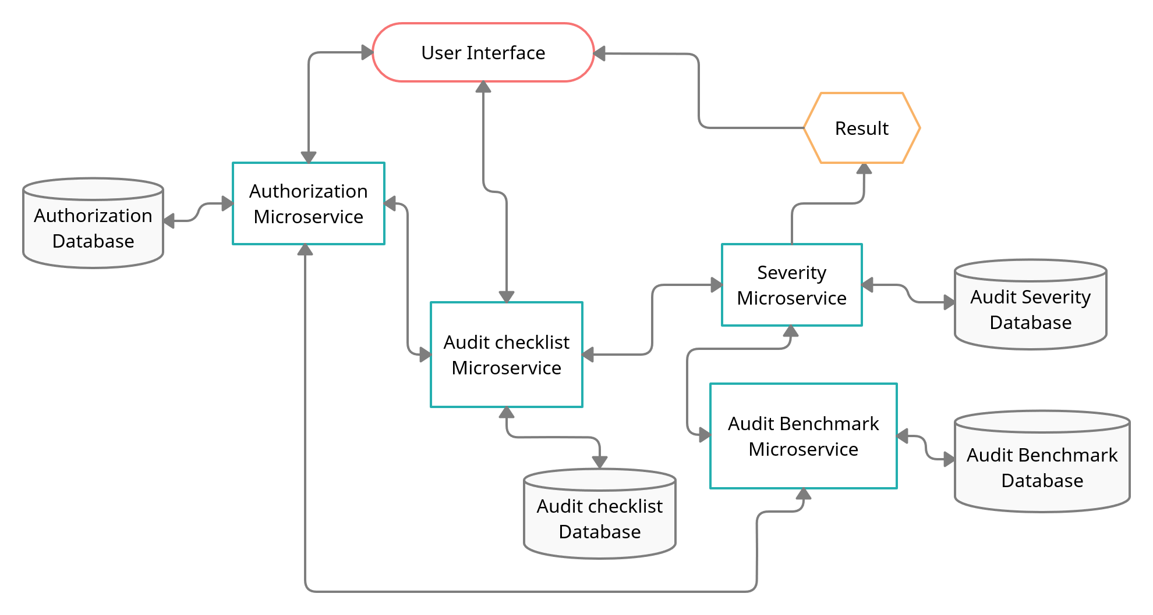
FLOWCHART

Slide 6
1. AUDIT AUTHORIZATION
Authentication and Authorization part of project.
It creates JWT (JSON Web Token) for an authenticated user who is in Database and then it validates the user based on the JWT token passed in the "Authentication"-Request-Header.
Method:
GET:/health-check
POST:/authenticate
POST:/validate

Slide 7
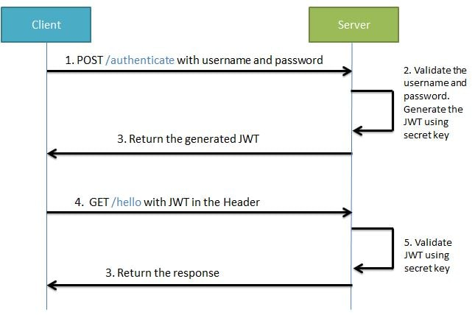

Slide 8
2. AUDIT BENCHMARK
It is a middleware microservice which stores the number of acceptable “No” in the database based on Audit Type.
It uses data.sql which stores Benchmark ID, Audit Type and Bechmark “No” answers.
It is used to pass the number of list of acceptable “No” to audit-severity microservice.
Method:
GET:/audit-benchmark
GET:/health-check

Slide 9
3. AUDIT-CHECKLIST
It is a middleware microservice which gets the list of questions from H2 database.
It uses data.sql which stores Question ID, Question, Audit Type and Response.
The returned list is used by the audit-severity to display questions based on the type selected by the user.
Method:
GET:/auditchecklistquestions
GET:/health-check

Slide 10
4. AUDIT-SEVERITY
It is a middleware microservice which invokes audit-benchmark microservice and takes the list of acceptable “No” from it and it also takes questions from audit-checklist based on that generates the response.
It then checks the project execution status according to the pre-set rules.
It returns the status and remedial action to be taken.
Method:
POST:/projectexecutionstatus
GET:/health-check

Slide 11
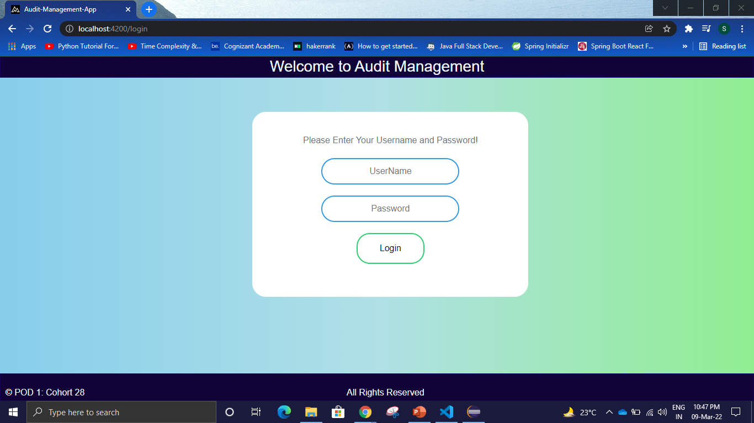
USER INTERFACE

Slide 12
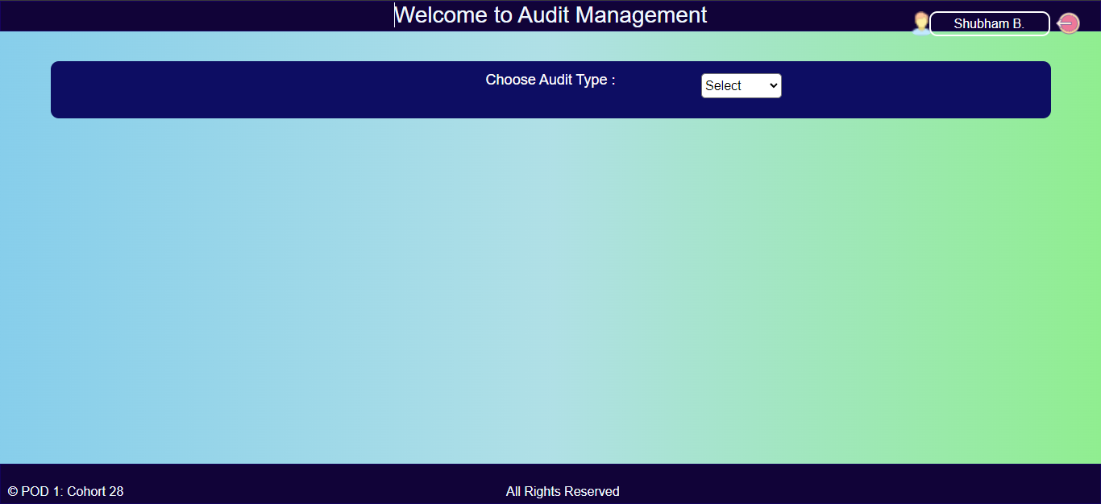
USER INTERFACE

Slide 13
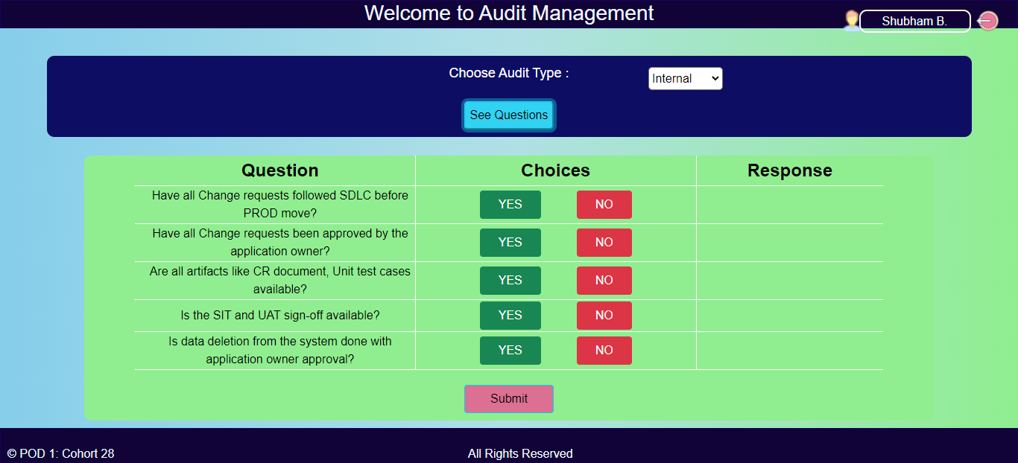
USER INTERFACE

Slide 14

USER INTERFACE

Slide 15
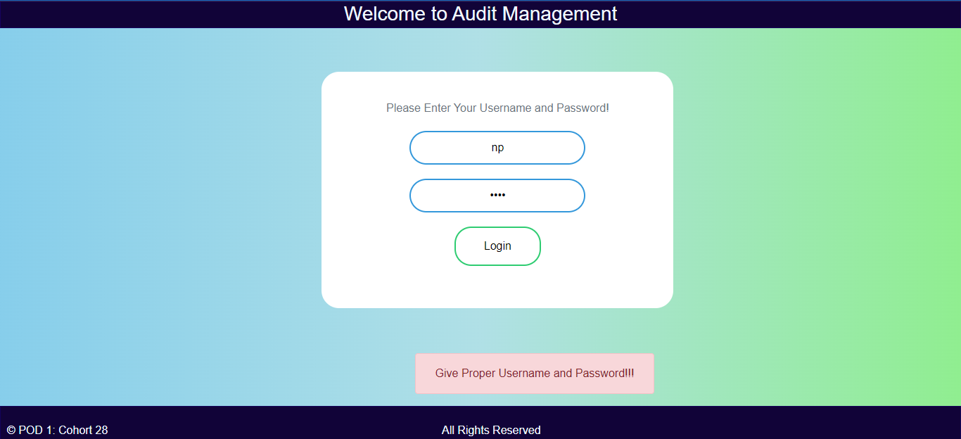
ERROR HANDLING

Slide 16
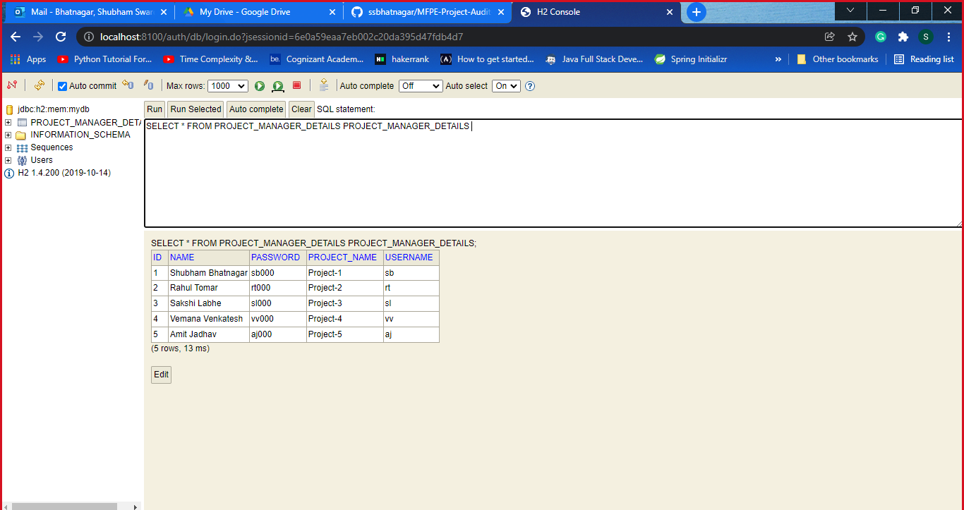
H2 DATABASE

Slide 17
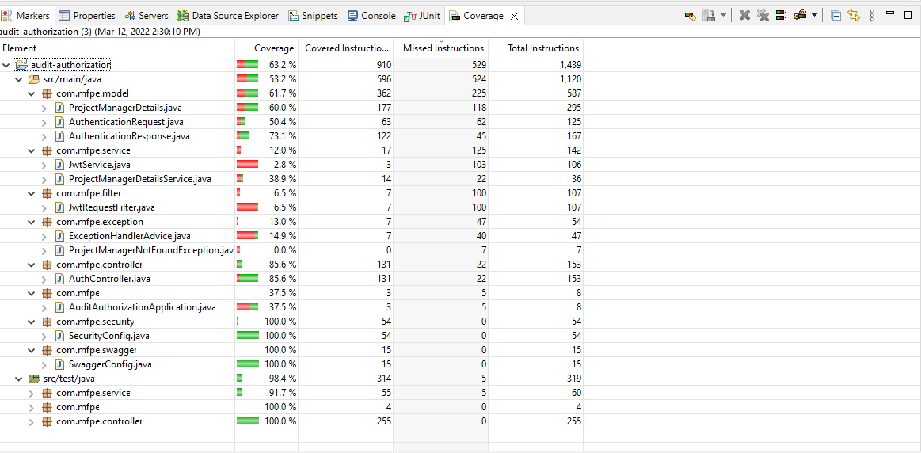
CODE COVERAGE

Slide 18
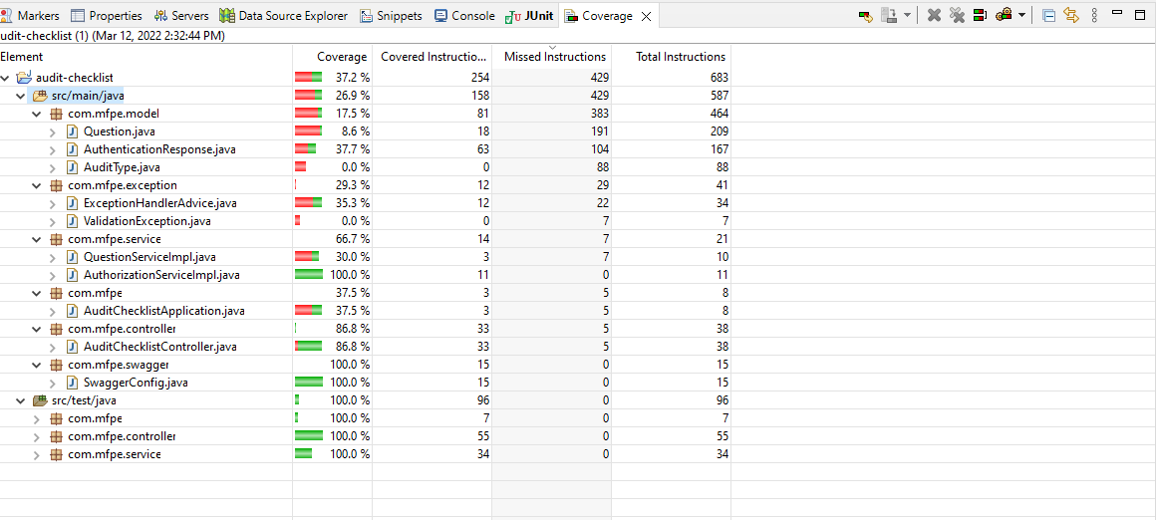
CODE COVERAGE

Slide 19
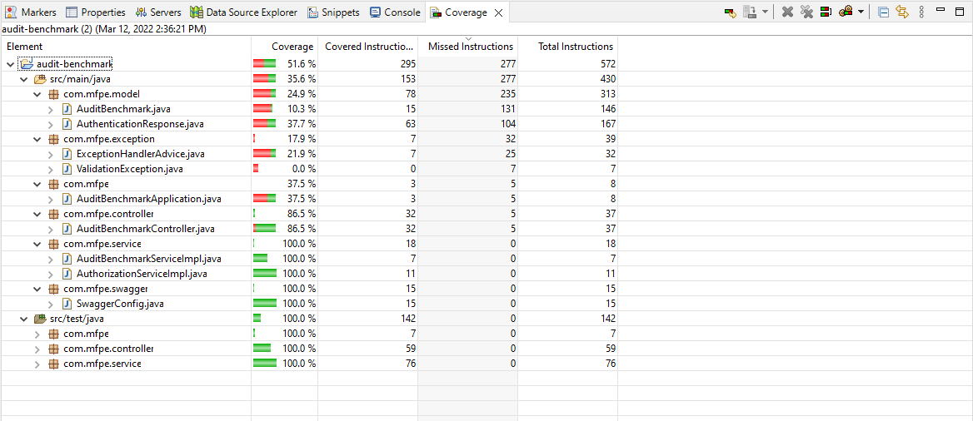
CODE COVERAGE

Slide 20
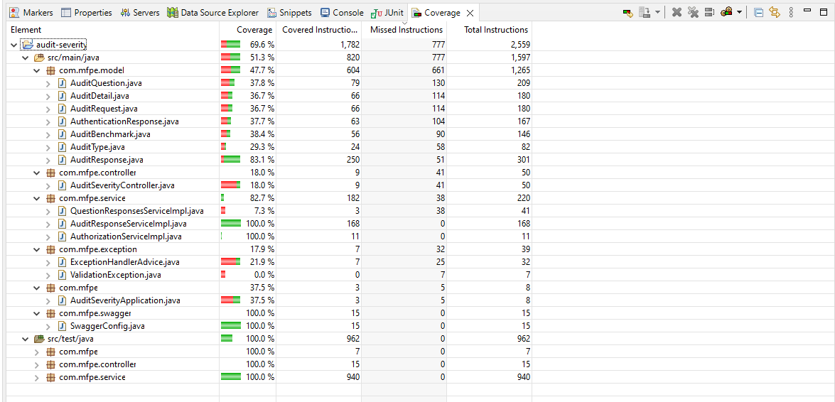
CODE COVERAGE

Slide 21
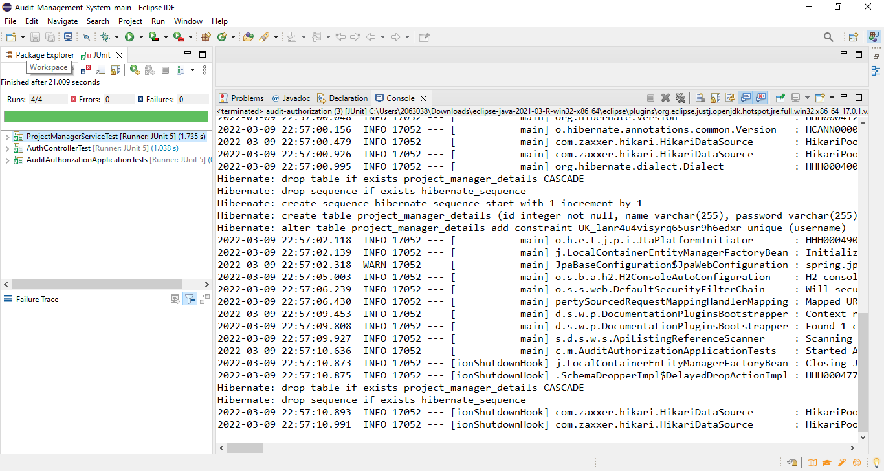
JUNIT

Slide 22
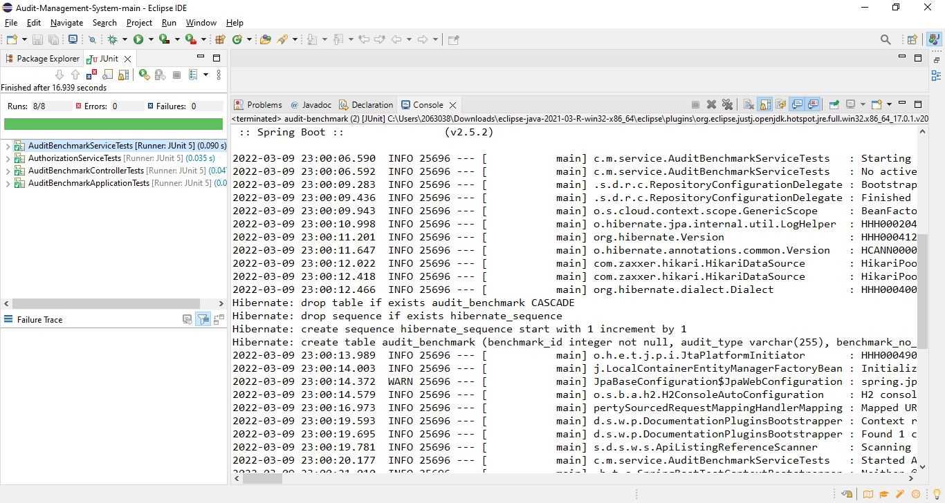
JUNIT

Slide 23
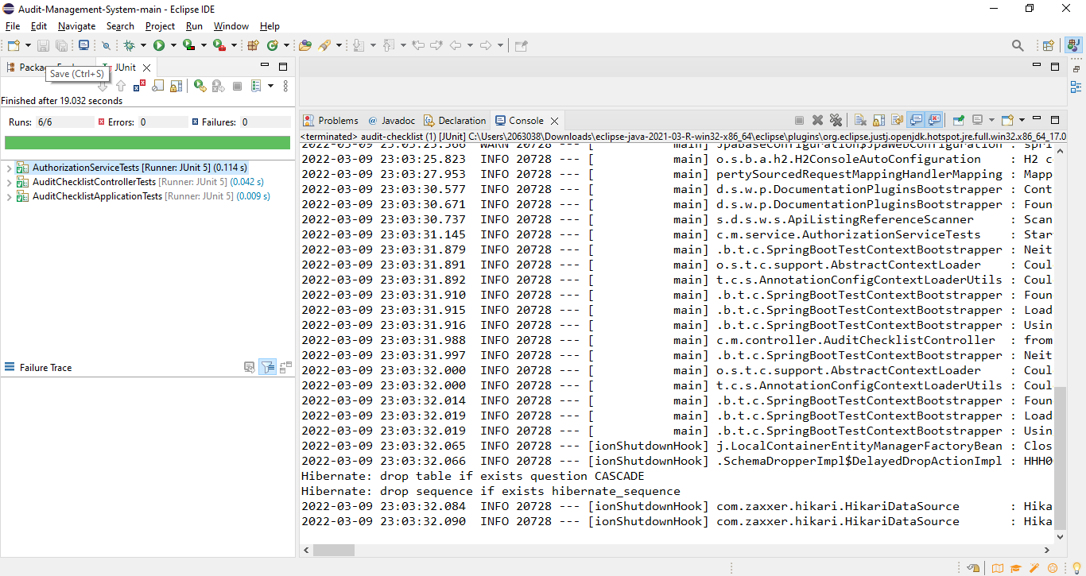
JUNIT

Slide 24
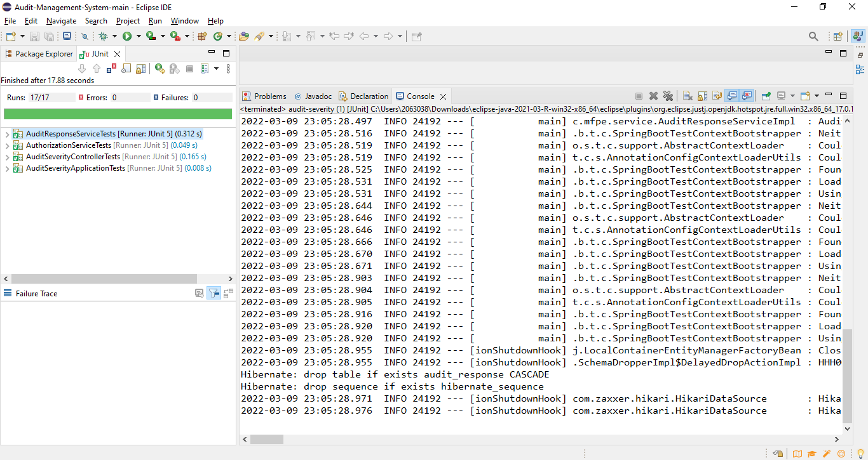
JUNIT

Slide 25
DEPLOYMENT LINKS
AWS Deployment Link
Private Repo Github

Slide 26
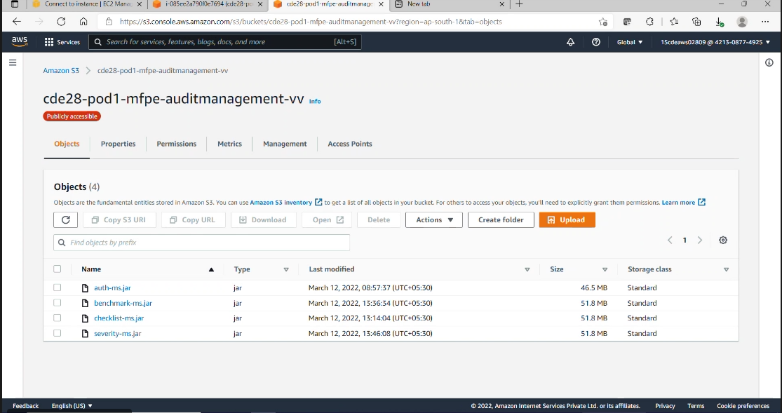
AWS DEPLOYMENT

Slide 27
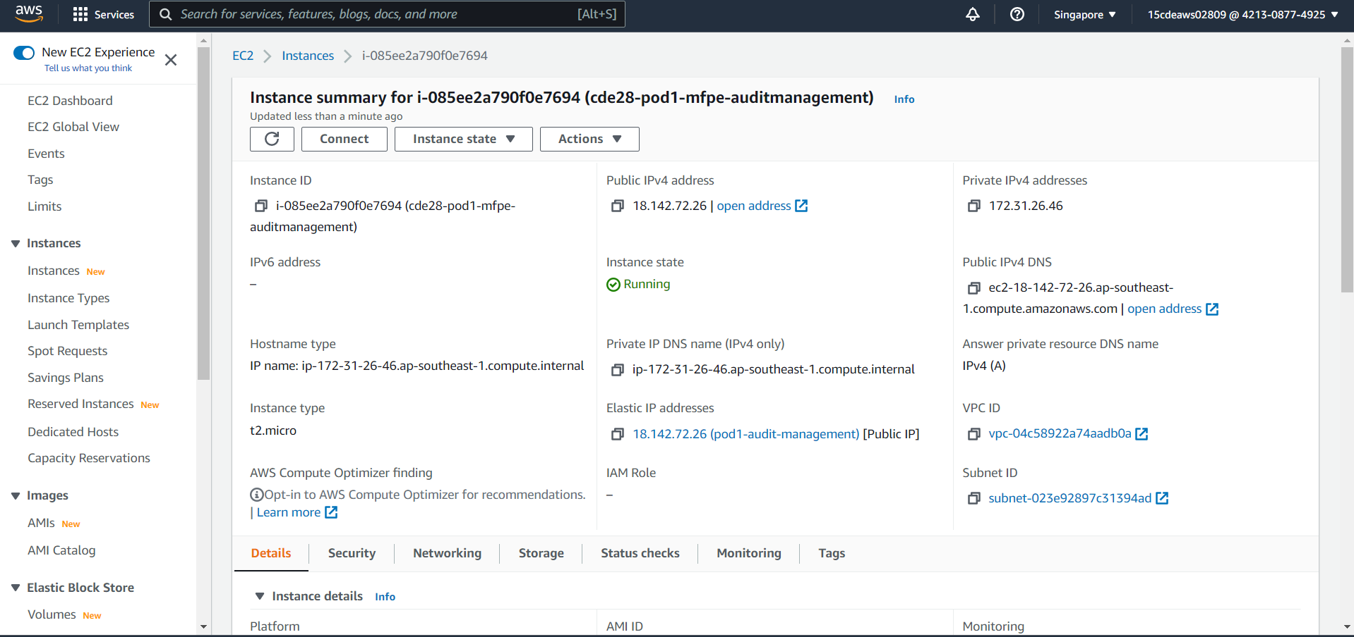
AWS DEPLOYMENT

Slide 28
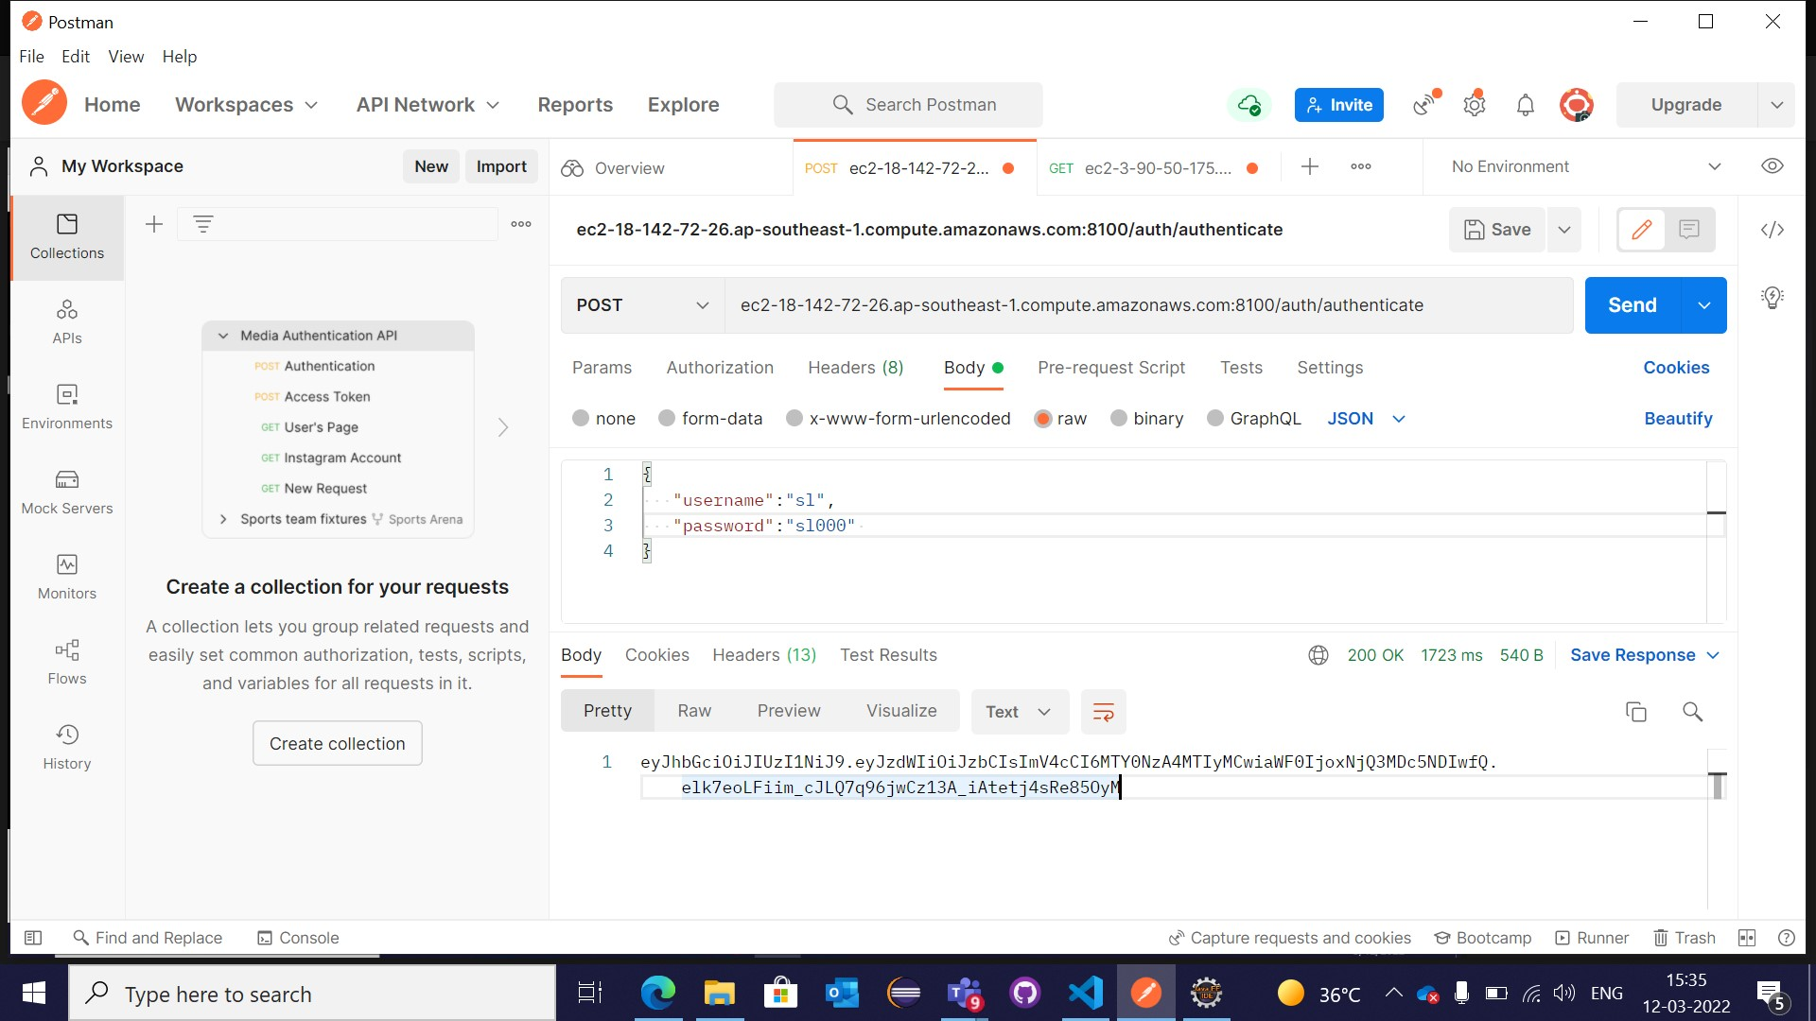
POSTMAN

Slide 29
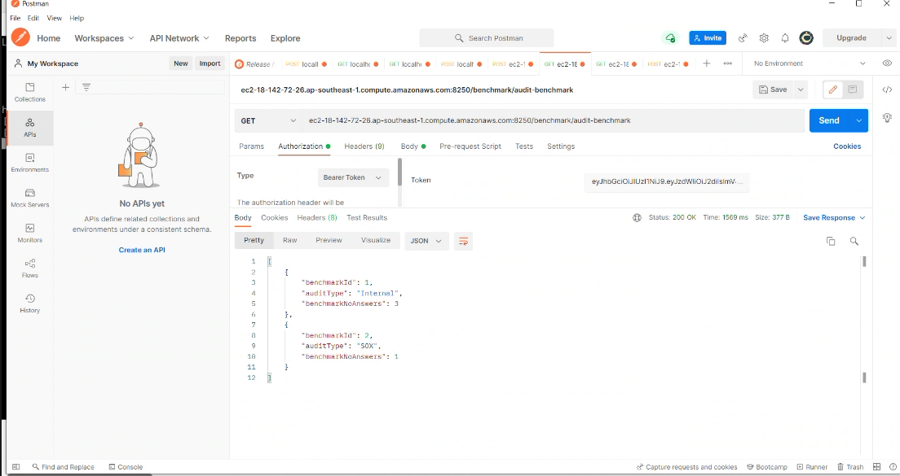
POSTMAN

Slide 30
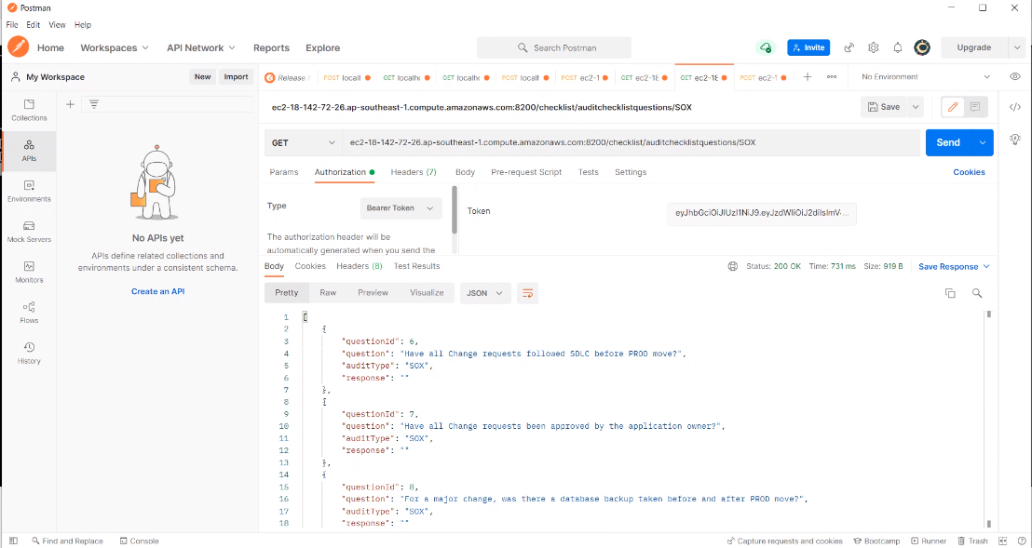
POSTMAN

Slide 31
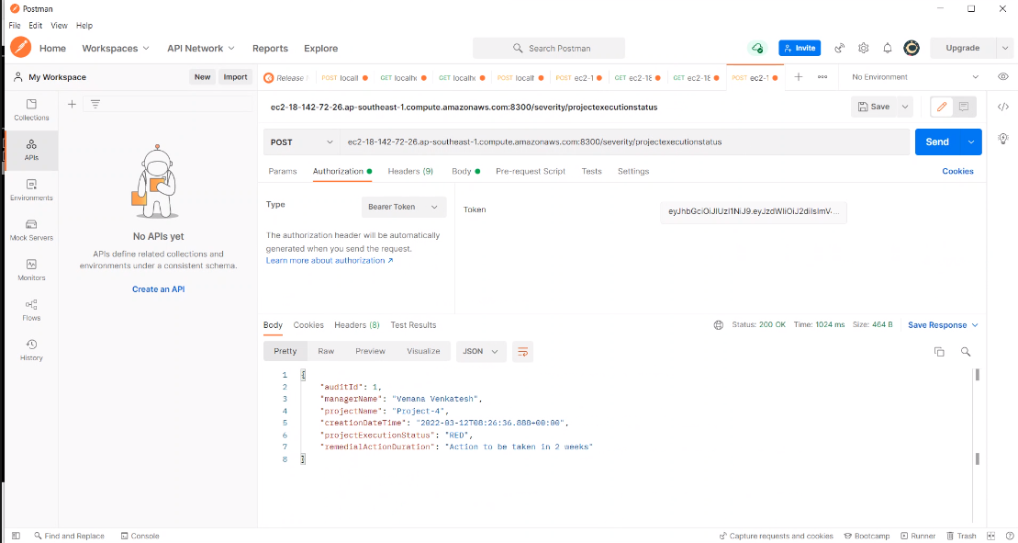
POSTMAN

Slide 32
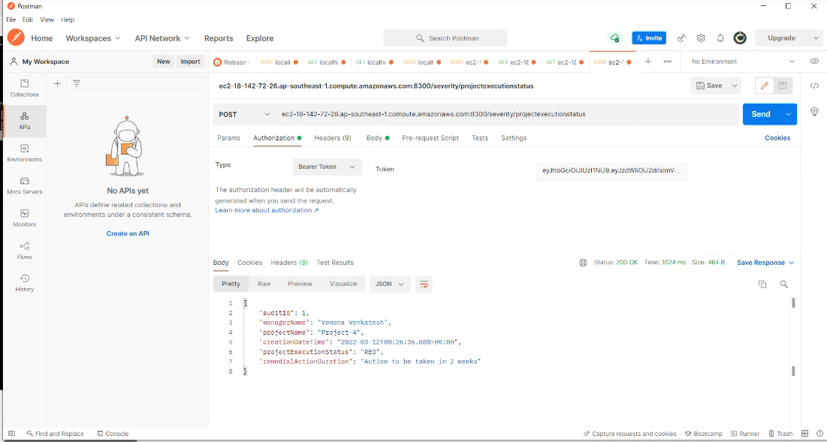
POSTMAN

Slide 33
LEARNING OUTCOMES
Learn
Learn from each other
Time
Time management, collaborative learning
Develop
Develop attitude necessary for success
Integrate
Integrate theory and practice
Assess
Assess interests and abilities in FSE field
Develop
Develop communication and interpersonal skills
Build
Build a record of work experience

Slide 34
THANK YOU

